Slide 1
Unit 1 Introduction

Slide 2
Marks Distribution
Internal Theory:30 marks (45%=13.5)
Internal Practical: 20 marks (45%= 9)
Final semester exam: 50 marks (45%=22.5)

Slide 3
References:
Mano, M.M. (2017). Digital Logic and Computer Design. Pearson Education India
Rafiquzzaman,M., &McNinch, S.A. (2019).Digital Logic: With an introduction to Verilog and FPGA-Based Design.John Wiley & Sons.
Digital Principles and applications(7th Edition) Donald P. Leach,Albert Paul Malvino,Goutam Saha
Digital Fundamentals(8th Edition) Floyd and Jain

Slide 4
Analog and Digital Signal
Signal is independent variable or function which carries certain information.
Types:
1. Analog signal
2. Digital signal

Slide 5
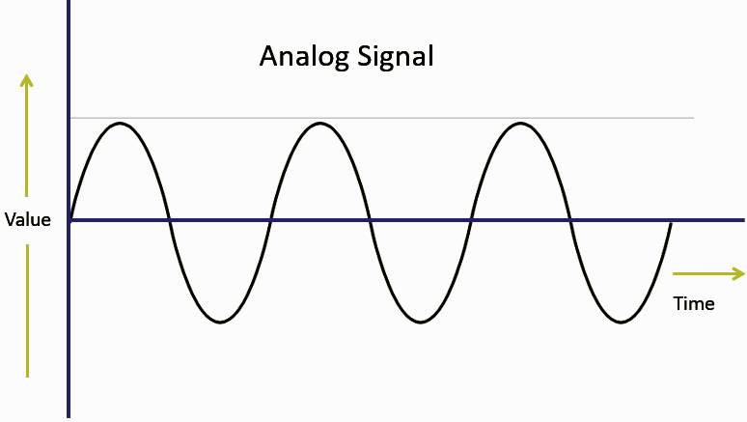
Analog Signal
Continuous time signal designed for every
value of time.
Can have infinite number of values.
Sine wave

Slide 6
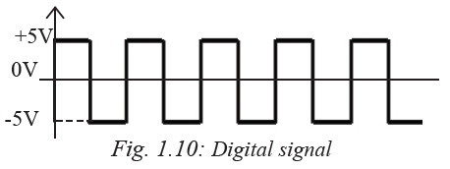
Digital Signal
Is non continuous discrete time signal.
Defined for certain instant of time so has finite number of discrete values.
Carries data or information in binary form (0 and 1)
Square wave

Slide 7
Analog and Digital system
System which operates on analog signals or has continuous values of data is called Analog System. Ex: Filters, Amplifiers
System which operates on digital signals or discrete data represented by binary values 0 and 1 is called Digital System. Ex: Flipflops, Microprocessor

Slide 8
Advantages of digital system
Digital data can be transmitted more efficiently and is more reliable than analog data.
Digital data can be stored in memory.
Digital signals are more immune to noise and interferences.
Multiple digital signals can be multiplexed together.
The transmission is more secure with encryption (data hiding).

Slide 9
Disadvantages of digital system
Digital circuits are often fragile, in that if a single piece of digital data is lost or misinterpreted, the meaning of large blocks of related data can completely change.
Digital computer manipulates discrete elements of information by means of a binary code.
Quantization error during analog signal sampling.

Slide 10
Analog System | Digital System
Operates on analog signal. | Operates on digital signal.
Is continuous in nature. | Is discrete in nature.
Relatively less noise immune. | Relatively more noise immune.
Uses continuous range of values to represent information. | Uses discrete range of values to represent information.
Stored in form of wave signal. | Stored in form of binary digits.
Less secure. | More secure due to use of encryption.
Difficulty in processing and receiving signal. | easy in processing and receiving signal.
Less efficient. | More efficient.

Slide 11
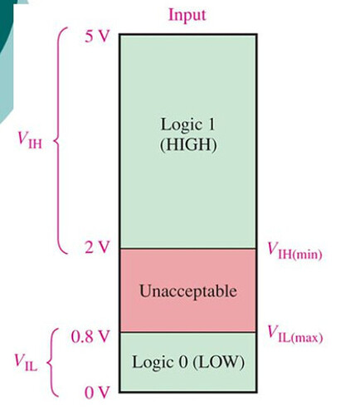
Numerical representation
In digital representation the quantities are represented by digits.
Logic Level in digital representation, 0 – 0.8V represents logic 0 and 2V – 5V represents logic 1.
Voltage between 0.8 V and 2 V are unacceptable
and are never used.

Slide 12
Digital number system
A pulse has a rapid transition (leading or rising edge) from a baseline to an amplitude level, then, after a period of time, a rapid transition (trailing or falling edge) back to the baseline level.
Pulses can be positive-going, or negative-going, depending upon the baseline.
The distance between rising and falling edge is termed the pulse width.

Slide 13
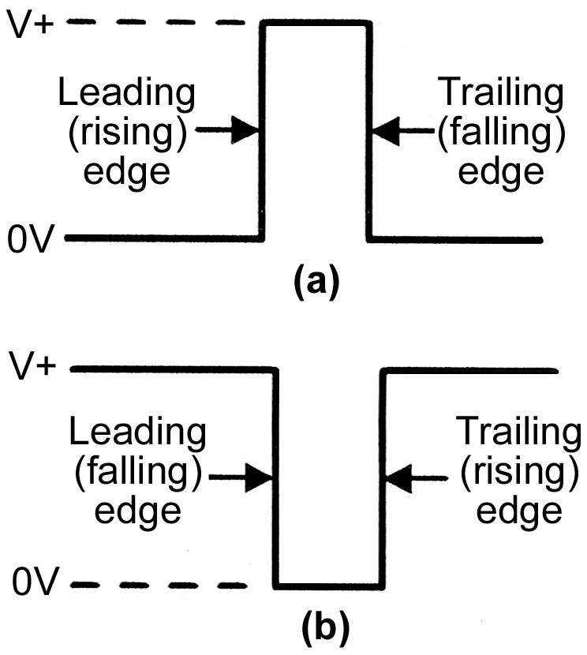
Ideal Pulse
A pulse has two edges:
1. Leading edge:
For positive pulse: Positive going transition(Rising edge)
For negative pulse: Negative going transition (Falling edge)
2. Trailing edge:
For positive pulse: Negative going transition(Falling edge)
For negative pulse: Positive going transition (Rising edge)

Slide 14
For a positive pulse logic system, the most positive voltage level represents logic 1 state or high level (H) and lowest voltage level represents logic 0 state or low level (L).
For a negative pulse logic system, the most positive voltage level represents logic 0 state and the lowest voltage level represents logic 1 state.

Slide 15
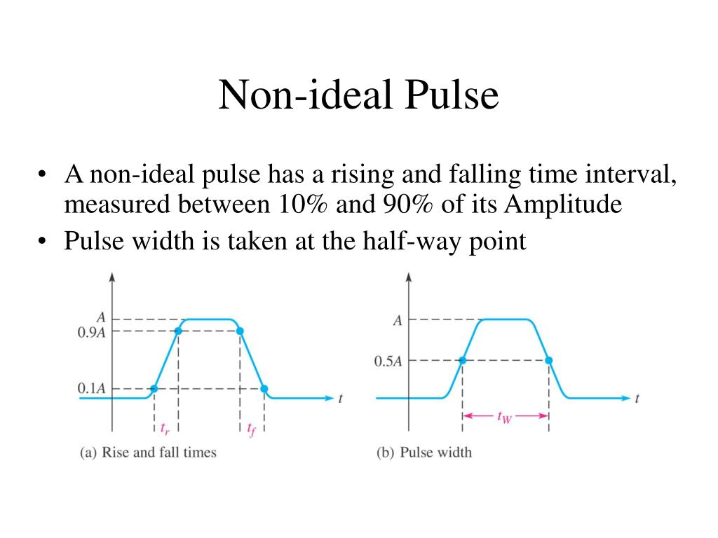
Non-ideal Pulse
A non-ideal pulse has a rising time(tr) and falling time(tf) interval, measured between 10% and 90% of its Amplitude.
Pulse width is taken at the half-way point(0.5A)

Slide 16
End of Unit 1

